Slide 1

Chapter 7 – part II

Slide 2
OUTLINE
  Conservative forces.
  Force and potential energy.
  Energy diagrams.
  Problems.

Slide 3
Conservative and nonconservative forces
A conservative force allows conversion between kinetic and potential energy. Gravity and the spring force are conservative.
The work done between two points by any conservative force
a) can be expressed in terms of a potential energy function.
b) is reversible.
c) is independent of the path between the two points.
d) is zero if the starting and ending points are the same.
A force (such as friction) that is not conservative is called a nonconservative force, or a dissipative force.

Slide 4
Conservation of energy
Dissipative forces do not store potential energy, but they do change the internal energy of a system.
The law of the conservation of energy means that energy is never created or destroyed; it only changes form.
This law can be expressed as ΔK + ΔU + ΔU_{int} = 0.

Slide 5
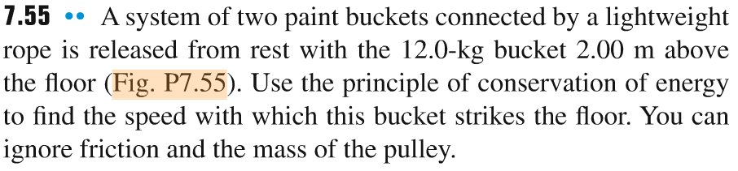
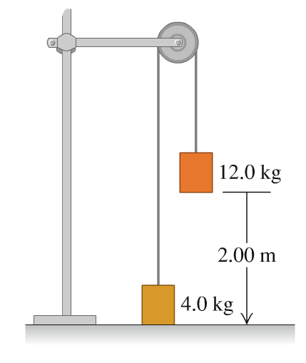
Problem #1

Slide 6
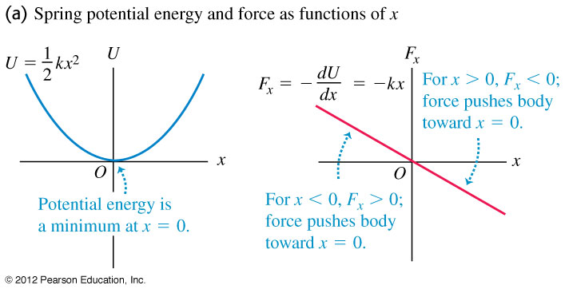
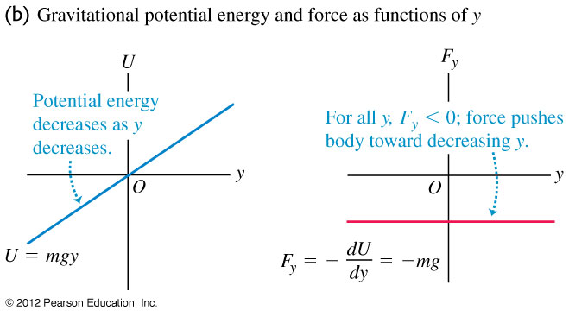
Force and potential energy
In one dimension, a conservative force can be obtained from its potential energy function using
F_{x}(x) = –dU(x)/dx
In two dimension, the components of a conservative force can be obtained from its potential energy function using
F_{x} = –dU/dx
F_{y} = –dU/dy

Slide 7
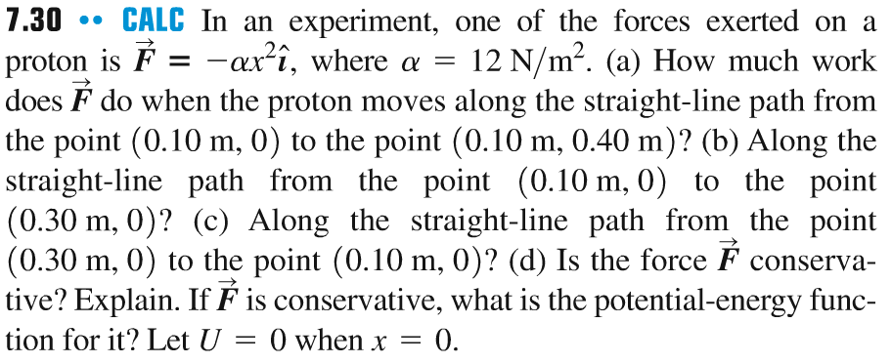
Problem #2

Slide 8

Problem #3
In the figure, a block of mass 5 kg is moving along the horizontal frictionless surface with a speed of 5.70 m/s. If the slope is 11.0° and the coefficient of kinetic friction between the block and the incline is 0.260, how far does the block travel up the incline?

Slide 9
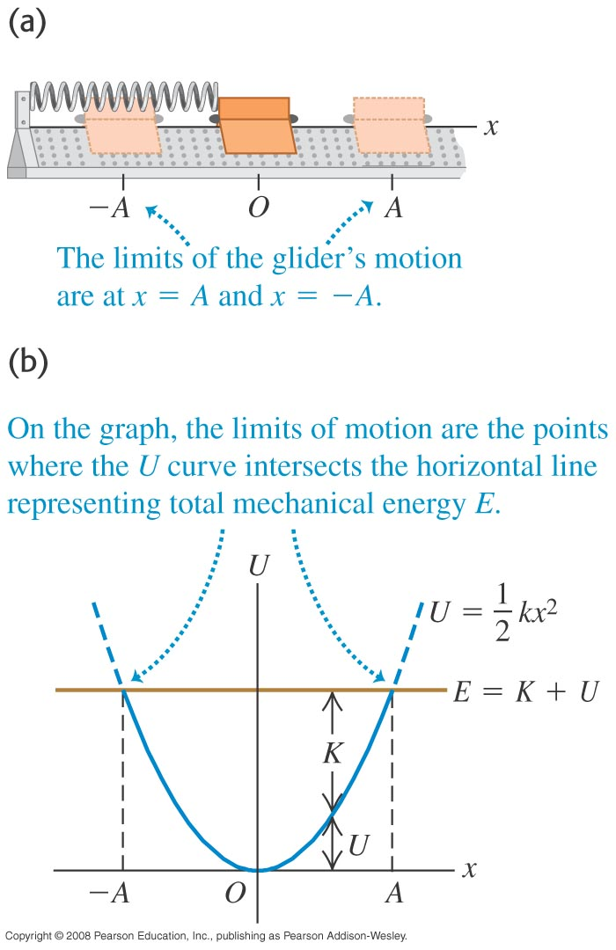
Energy diagrams
An energy diagram is a graph that shows both the potential-energy function U(x) and the total mechanical energy E.
Figure illustrates the energy diagram for a glider attached to a spring on an air track.

Slide 10
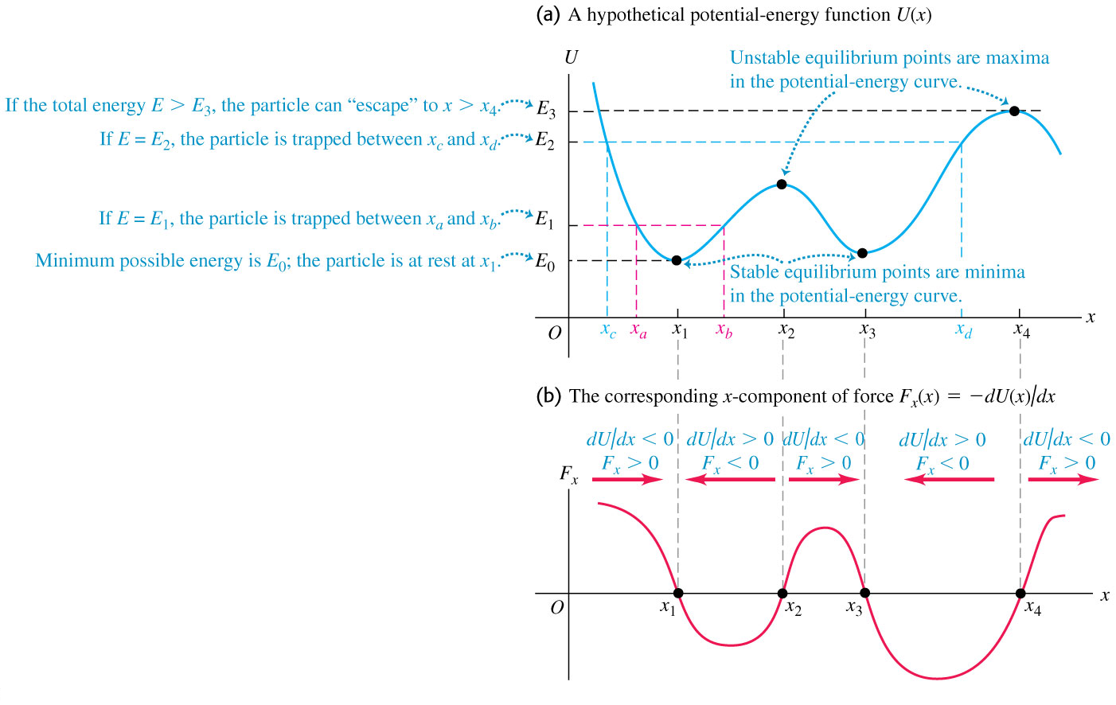
Force and a graph of its potential-energy function

Slide 11
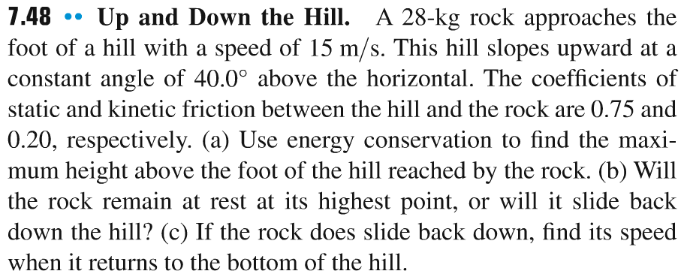
Problem #4

Slide 12
Problem #5
Block 1 and block 2 have the same mass, 10 kg, and are released from the top of two inclined planes of the same height, 4 m, making 30° and 60° angles with the horizontal direction, respectively. If both inclines have a kinetic friction coefficient of 0.2, which of the blocks is going faster when it reaches the bottom of its respective incline?
h
h
30⁰
60⁰

